Slide 1
Unit 13 Analysis of Research Articles
山东大学大外部

Slide 2
1. An Introduction to Research Articles
2. Title
3. Author Affiliation
4. Abstract

Slide 3
1. An Introduction to Research Articles
A research article, also referred to as a scholarly article, is an academic work that is usually published in an academic journal. It is a detailed account of a research activity by the researcher who does the research as a primary resource.

Slide 4
Research Articles
A research article generally consists of the following parts:
title and author affiliation
abstract
key words
introduction
methods or methodology
results
discussion
conclusion
references

Slide 5
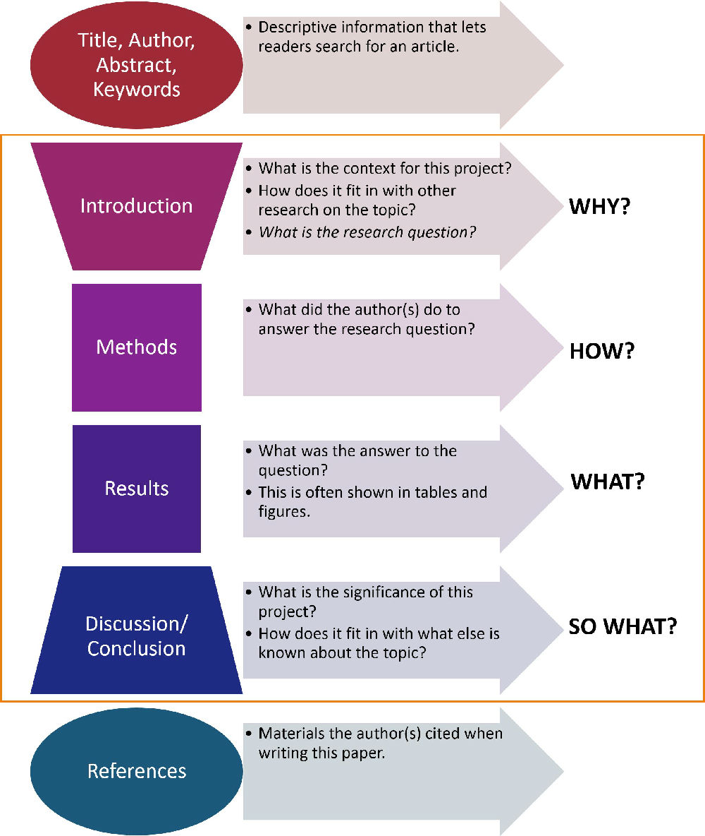
Research Articles

Slide 6
Research Articles
IMRAD format
What is IMRAD?
IMRAD is an acronym standing for:
Introduction
Methods (or, sometimes ‘Materials and Methods’)
Results
Discussion
The order of these sections reflects the process of scientific discovery, which is why it is a nearly universal format for research papers.

Slide 7
Research Articles
Section | Purpose
Introduction | Defines problem and structure of paper
Methods | Explains how the data were collected
Results | Describes what was discovered
Discussion | Discusses the implications of the findings
Conclusion | Brings together question/hypothesis, findings, analysis, and discussion
Note: When writing a paper, the IMRAD sections compromise the main content and context of the article.

Slide 8
Research Articles
Structure of a Research Paper
Section | Purpose
Title | Concisely describes contents/main finding
Authors | Ensures recognition for the writer(s)
Abstract | Describes paper, main findings, conclusion
Key words | Ensure the article is correctly identified

Slide 9
Research Articles
Section | Purpose
References | Ensure previously published work is recognized
Appendices | Some journals ask for supplemental data
Acknowledgements | Ensure those who helped in the research are recognized

Slide 10
2. Title
The title is the main indication of an article's subject and the main source of information for doing relevant judgment at the time of literature searching.
Features
1) using more nouns or noun phrases, or gerunds
2) being brief and concise
3) being specific
4) using more compounds
5) Being informative
6) Emphasizing on creativity and contribution

Slide 11
（1）Types of titles
1) Declarative titles (声明型标题)
This type of titles makes a declaration and states the main findings or conclusions of the article.
E.g. Organic Food is Healthier than Genetically Modified Food
Lack of Sleep as a Contributor to Obesity in Adolescents
Promoting Active Learning and Classroom Interaction through Effective Questioning Strategy

Slide 12
（1）Types of titles
2) Descriptive titles （描述型标题）
This type of titles describes the subject of the article and does not reveal the outcome or conclusion.
E.g. A Comparative Study of Organic Food and Genetically Modified Food
A Study on the Factors Affecting the Infant Feeding Practices
of Mothers in Las Piñas City An Error analysis of English writing through Korean college student's English compositions
An Empirical Study on the Writing Ability of College Students with the Error Analysis Approach

Slide 13
（1）Types of titles
3) Interrogative titles （疑问型标题）
This type of title indicates the subject of the article in the form of a question and commonly avoids the conclusion of the research.
E.g. Is GM Food More Environmentally Friendly than Organic Food?
Do Exercise and Cognitive Training Improve Cognition in Older Adults?
Note: Interrogative titles are less common though they seem to be more frequent in reviews than in research articles.

Slide 14
（1）Types of titles
4) Compound titles （复合型标题）
This type of titles consists of two parts.（主标题和副标题）
E.g. Error in Foreign Language: Analysis and Treatment
Analysis and Reflection on the Idea of “New Engineering” and Training of China’s Engineering Majors

Slide 15
（2）Clue words in titles
analysis of …
exploration of…
insight into…
research on…
study of …
……
Refer to 02 on Page 49.

Slide 16
(3) Reading skills
When reding the title, you need to identify:
which words/phrases are the most fundamental
→ major information
and which are supplementary.
→ minor information

Slide 17
(4) Sample analysis
E.g. Insights into the relationship between antimicrobial residues
1 2 3
and bacterial in a hospital-urban wastewater plant system
4
Analysis: From the numbers for the underlined word chunks, we can see the order of importance of all the words/word chunks, and accordingly distinguish the major information and minor information.

Slide 18
(5) Reading Practice
Read the following titles. Rank the words/word chunks according to their importance.
1. A contrastive study of online peer feedback and online
teacher feedback on Chinese college students' English writing
（中国大学生英语写作在线同伴反馈和教师反馈对比研究,蔡基刚,2011）
2. Changes in Air Pollution During COVID-19 Lockdown in Spain: A Multi-city Study
3. Impacts of Fireworks on Air Pollution during the Spring Festival in Tianjin City
（天津春节期间烟花爆竹燃放对空气质量的影响,郝天依等,2019)
4. Analysis on the Status Quo of Water Pollution and Its Treatment Technology in Rural Areas of China
（我国农村水污染现状及其处理技术分析，闵宗谱等，2016）

Slide 19
3. Author affiliation （作者的信息）
If there is more than one author, the lead author is listed at the beginning and the corresponding author is usually marked with a little star, such as Juan L.Acero*.
If there is more than one author and the authors come from different universities or institutions, there will be corresponding markers of either letters or numbers.
Study the sample on page 50.

Slide 20
Biochemical properties of compost tea associated with compost quality and effects on pakchoigrowth
Archana P. Pant, Theodore J.K. Radovich∗, Nguyen V. Hue, Robert E. Paull
Department of Tropical Plant & Soil
Sciences, University of Hawaii, 3190 MaileWay, Honolulu, HI, 96822, United States

Slide 21
Reading Skills
When reading the author affiliation, identify the following information:
How many authors are there?
What university/institution does the author belong to?
3. Who is the corresponding author?
4. The author’s address/email address/personal homepage…

Slide 22
Reading practice
Electrochemical impedance spectroscopy analysis of sulfonated polyethersulfone nanofiltration membrane
Ying Xu, MengWang*, ZhunMa, CongjieGao
Key Laboratory of Marine Chemistry Theory and Technology, Ministry of Education, China. College of Chemistry and Chemical Engineering, Ocean University of China, Qingdao 266100, Shandong Province, China

Slide 23
Harnessing big data for estimating the energy consumption and driving range of electric vehicles
GebeyehuM. Fetene a*, SigalKaplan a, b, Stefan L. Mabit a, Anders F. Jensen a, Carlo G. Prato c,
a Department of Management Engineering, Technical University of Denmark, Bygningstorvet 116B, 2800 Kgs. Lyngby, Denmark
b Department of Geography, Hebrew University of Jerusalem, Mount Scopus, 91905 Jerusalem, Israel
c School of Civil Engineering, The University of Queensland, St. Lucia 4072, Brisbane, Australia

Slide 24
4. Abstract
The abstract is found at the beginning of a research article. It provides you with a complete, but very concise summary of the paper.
Abstracts are often included in article databases, and are usually free to readers. Thus, they may be the most widely read portions of scientific papers.

Slide 25
What is the purpose of an abstract?
An abstract is a concise summary of a research article. It serves two main purposes:
To help potential readers determine the relevance of your paper for their own research.
To communicate your key findings to those who don’t have time to read the whole paper.
Abstracts are often indexed along with keywords on academic databases, so they make your work more easily findable. Since the abstract is the first thing any reader sees, it’s important that it clearly and accurately summarizes the contents of your paper.

Slide 26
How long is an abstract?
An abstract needs to convey a complete synopsis of the paper, but within a tight word limit. This restriction is where the difficulties lie.
Abstracts can also be difficult to read as an entire publication. They must be summarized in an understandable way in about 100-300 words.
Suppose you are given a maximum word count for an abstract, such as 200 words, it is essential that you remain within this limit.

Slide 27
Linguistic Features
accurate
concise
specific
independent
objective
self-contained

Slide 28
Components
Purpose (background and problems)
methods
results (important data and major findings)
conclusion (implication of the results, gaps remaining further study and future research directions)

Slide 29
Types
informative abstracts 报道性/信息性摘要
indicative/descriptive abstracts 指示性/描述性摘要
structured abstracts 结构性摘要
graphical abstracts 图文摘要
Refer to 01-04, P56-58

Slide 30
Reading Skills
While reading the abstract of a research article, you need to answer the following questions:
Why was the research conducted? → background
What was done? → problems
How was it done? → methods
What was found? → results
What was concluded? → conclusion

Slide 31
Sample Analysis
Read the following abstract of a research article and analyze it in terms of the above-mentioned components.

Slide 32
UK environmental organizations currently face a significant funding gap. It is well-established that representations of individual victims are more effective than abstract concepts like climate change when designing fundraising campaigns. This study aims to determine how such representations can be better targeted in order to increase donations. Specifically, it investigates whether the perceived social distance between victims and potential donors has an impact on donation intention. In this context, social distance is defined as the extent to which people feel they are in the same social group (in-group) or another social group (out-group) in relation to climate change victims.
Problem
The first sentence establishes the topic and main problem that the research addresses.
Background
There is a brief summary of the scholarly context to show the study's relevance.
Objective
Next, the specific objective of the research is stated.
Definition
If your abstract uses specialized terms that would be unfamiliar to the average academic reader, give a concise definition.

Slide 33
To test the hypothesis that smaller social distance leads to higher donation intention, an online survey was distributed to potential donors based across the UK. Respondents were randomly divided into two conditions (large and small social distance) and asked to respond to one of two sets of fundraising material. Responses were analyzed using a two-sample test. The results showed a small effect in the opposite direction than hypothesized: large social distance was associated with higher donation intention than small social distance.
Hypothesis
The study's hypothesis is clearly stated.
Methods
The next step is a brief description of the methods used.
Results
The most relevant results are summarized.

Slide 34
These results suggest that potential donors are more likely to respond to campaigns depicting victims that they perceive as socially distant from themselves. On this basis, the concept of social distance should be taken into account when designing environmental fundraising campaigns.
Conclusion
Finally, the study's main conclusions are stated, showing how the results answer the study's objective. As this research focused on a practical problem, it also includes recommendations.

Slide 35
Reading Practice
Read the following abstract. Can you answer the following questions?
1. Why was the research conducted?
2. What was done?
3. How was it done?
4. What was found?
5. What was concluded?

Slide 36
Abstract 1
Informed by literature on developing pedagogical content knowledge (PCK) through teacher collaboration, this study aims to investigate the trajectory of PCK development among business English teachers through module team collaboration in Chinese context. Drawing upon multiple sources of data including observation, semi-structured interview, and teaching materials from three case teachers, this study explores how PCK components were developed in one academic year when case teachers participated in module team collaborative activities. The findings show the individual differences among the three participants in their PCK development and reveal that two key PCK components -- Knowledge of students' understanding and Knowledge of instructional strategies have developed through teacher collaboration. This study suggests the collective inquiry in teacher collaboration.

Slide 37
Reading Practice
The following expressions may give you a hint.
1. Why was the research conducted?
This paper attempts to…
This paper discusses…
The purpose/chief aim/primary objective of the research is…
This study aims to…
2. What was done?
explore…, investigate…
3. How was it done?
in this method, methodology, be applied to…, by…,

Slide 38
Reading Practice
4. What was found?
data show…, results, findings
5. What was concluded?
The author concludes…, suggest…, in conclusion

Slide 39
Reading Practice Abstract 2
The question of whether or not children from low socioeconomic groups can raise their level of achievement and success should be of vital concern to today’s society. This problem greatly impacts our educational system, even though all students are theoretically offered equal learning opportunities. Several reasons why children from impoverished homes often do poor in school are explored in this article. Some of these factors include health concerns, lack of cognitive stimulation, physical environment, attitudes and values of parents and other family members, mobility rate, and low teacher-expectations. Much can be done to help these at-risk children and thus to minimize the negative effects that their condition creates for society in general. Good early childhood education programs can be very beneficial.

Slide 40
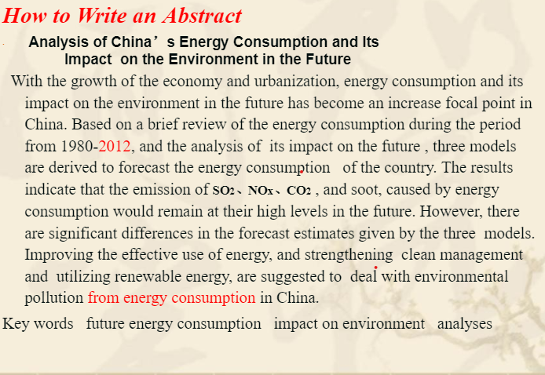
Reading Practice Abstract 3

Slide 41
Reading Practice Abstract 4
The COVID-19 pandemic has escalated into one of the largest crises of the 21st Century. The new SARS-CoV-2 coronavirus, responsible for COVID-19, has spread rapidly all around the world. The Spanish Government was forced to declare a nationwide lockdown in view of the rapidly spreading virus and high mortality rate in the nation. This study investigated the impact of short-term lockdown during the period from March 15th to April 12th 2020 on the atmospheric levels of CO, SO₂, PM10, O₃ and NO₂ over 11 representative Spanish cities. The possible influence of several meteorological factors (temperature, precipitation, wind, sunlight hours, minimum and maximum pressure) on the pollutants’ levels were also considered. The results obtained show that the 4-week lockdown had significant impact on reducing the atmospheric levels of NO₂ in all cities except for the small city of Santander as well as CO, SO₂, and PM10 in some cities, but resulted in increase of O₃ level.

Slide 42
Reading Practice Abstract 5
Sleep is an important contributor to physical and mental health; however, chronic sleep deprivation has become common in adolescents, especially on weekdays. Adolescents aged 14-17 years are recommended to sleep between 8 and 10 hours per night to maximize overall health and well-being. Although sleep needs may vary between individuals, sleep duration recommendations are important for surveillance and help inform policies, interventions, and the population of healthy sleep behaviors. Long sleepers are very rare among teenagers and sleeping too much is not a problem per se; only insufficient sleep is associated with adverse health outcomes in the pediatric population. Causes of insufficient sleep are numerous and chronic sleep deprivation poses a serious threat to the academic success, health and safety of adolescents. This article focuses on the link between insufficient sleep and obesity in adolescents.

Slide 43
Reading Practice Abstract 5
This "call to action" article argues that sleep should be taken more seriously by the public health community and by our society in general, i.e., given as much attention and resources as nutrition and physical activity. Not only that having a good night's sleep is as important as eating a healthy diet and being regularly physically active for overall health, but sleeping habits also impact eating and screen time behaviors and, therefore, can influence body weight control. Short sleep duration, poor sleep quality, and late bedtimes are all associated with excess food intake, poor diet quality, and obesity in adolescents. Sleep, sedentary behavior, physical activity and diet all interact and influence each other to ultimately impact health. A holistic approach to health (i.e., the whole day matters) targeting all of these behaviors synergistically is needed to optimize the impact of our interventions. Sleep is not a waste of time and sleep hygiene is an important factor to consider in the prevention and treatment of obesity.

Slide 44
Homework
Do Exercise 1 and Exercise 2 on page 53 in your textbook.
Search some research articles in your field.
* Analyze one title for each type, rank the words and phrases in each title according to their importance.
* Read the abstracts and identify the components (How many parts? What are they?)

Slide 45


Slide 46
Appendix Answer to the abstract sample analysis
Problem
The first sentence establishes the topic and main problem that the research addresses.
Background
There is a brief summary of the scholarly context to show the study's relevance.
Objective
Next, the specific objective of the research is stated.
Definition
If your abstract uses specialized terms that would be unfamiliar to the average academic reader or that have various different meanings, give a concise definition.

Slide 47
Hypothesis
The study's hypothesis is clearly stated.
Methods
The next step is a brief description of the methods used.
Results
The most relevant results are summarized.
Conclusion
Finally, the study's main conclusions are stated, showing how the results answer the study's objective. As this research focused on a practical problem, it also includes recommendations.

